Slide 1
Hi-C and ChIP-seq for Histone modifications, TFBSs, DNAaseI Hypersensitivity and ATAC-seq Analysis
March 29 2025
Phuc-Loi Luu, PhD

Slide 2
Content
Hi-C
ChIP-seq for Histone modifications, TFBSs, DNAaseI Hypersensitivity
ATAC-seq

Slide 3
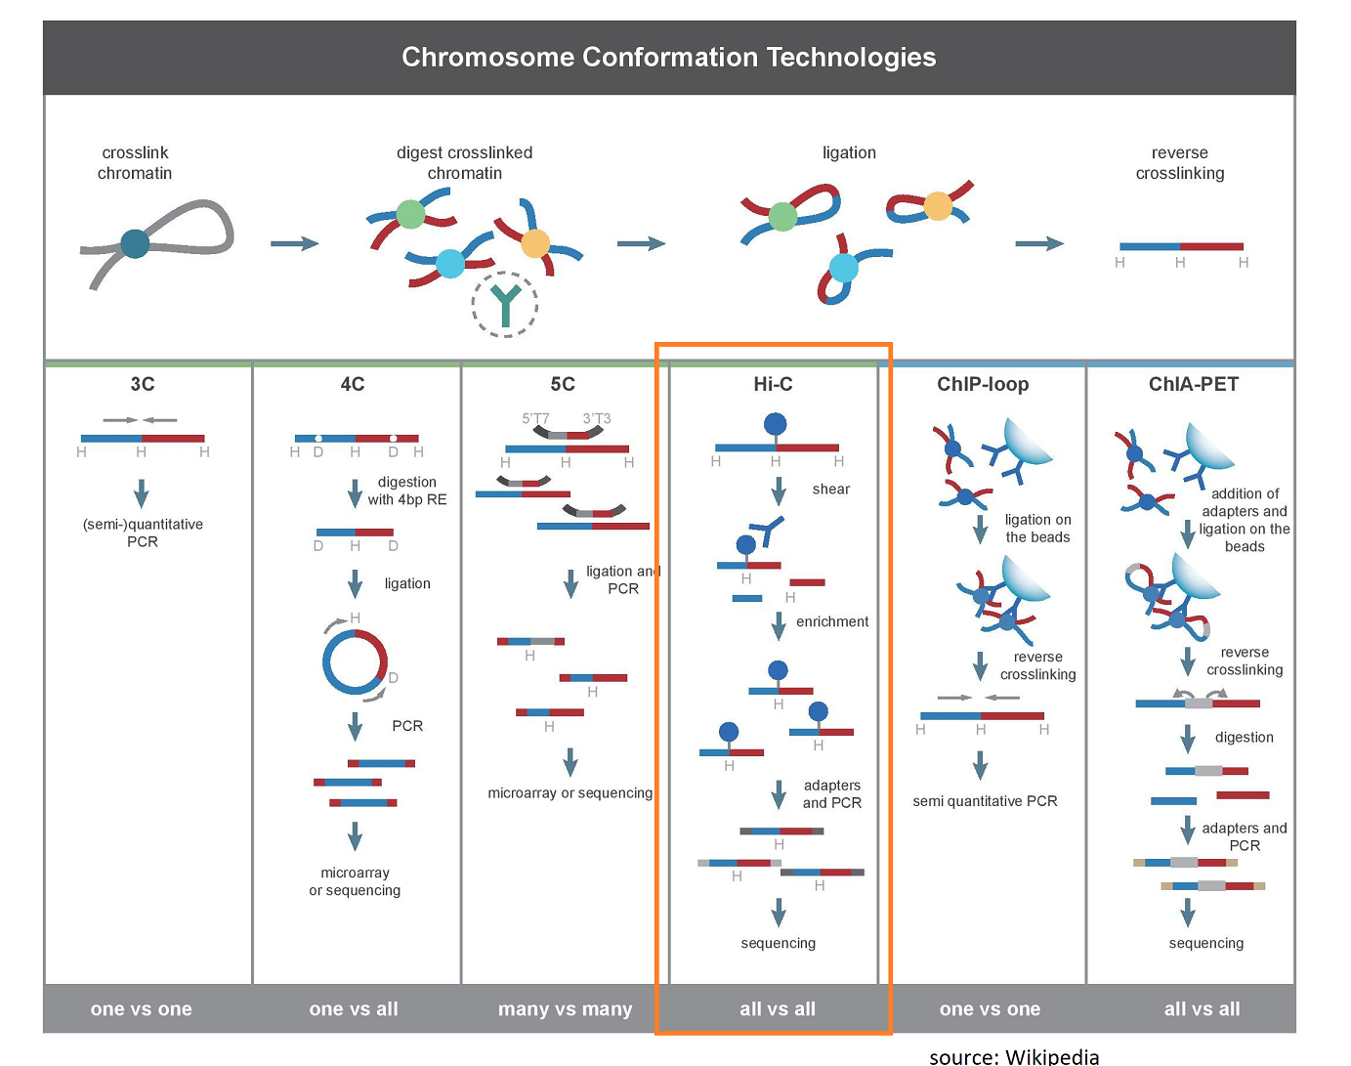
https://dnatech.ucdavis.edu/hi-c-library-preparations-and-sequencing

Slide 4
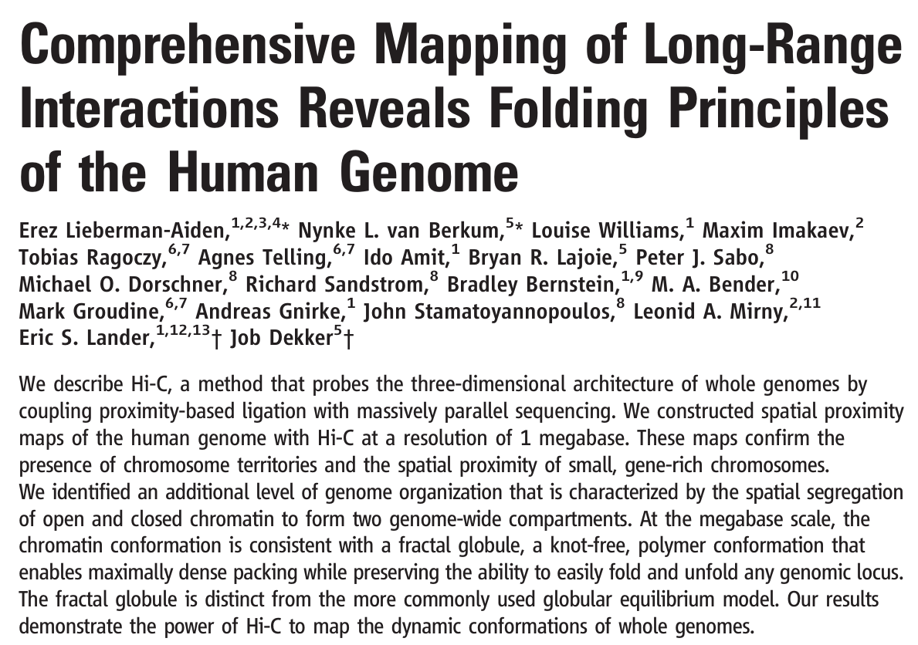

Hi-C

Slide 5
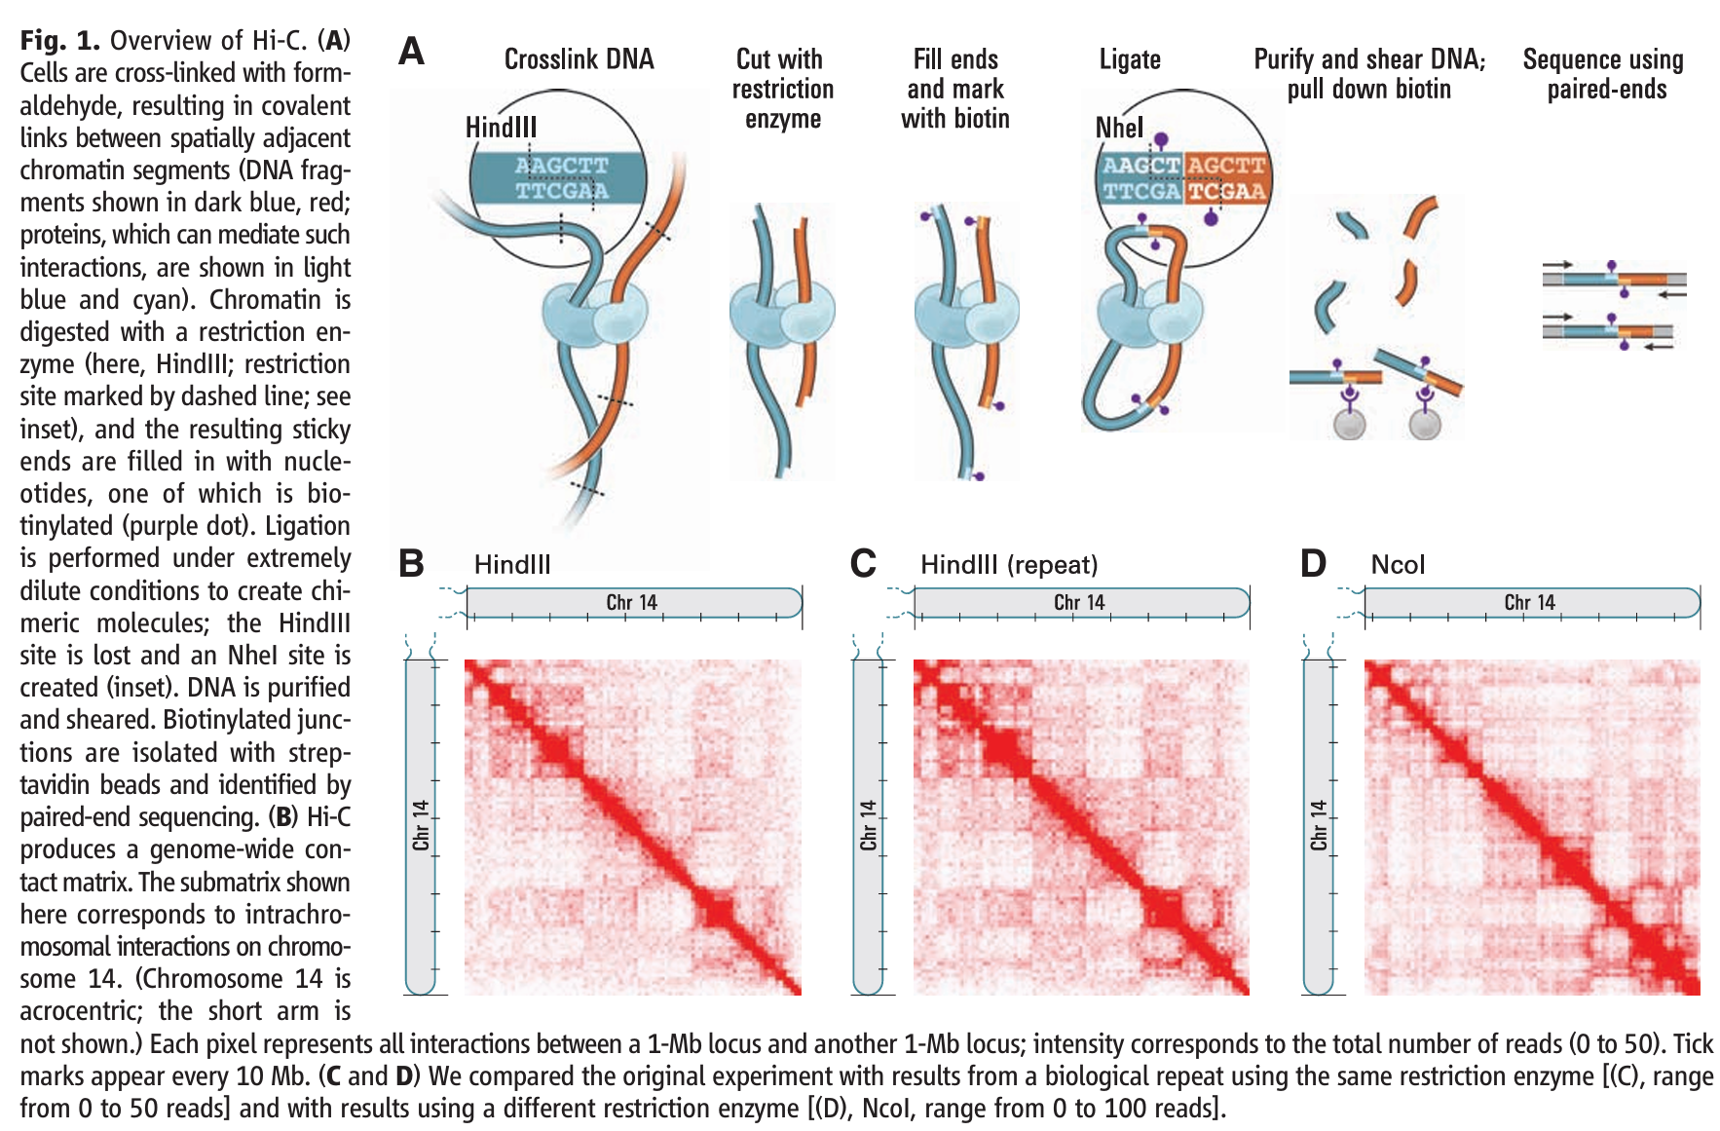

Slide 6
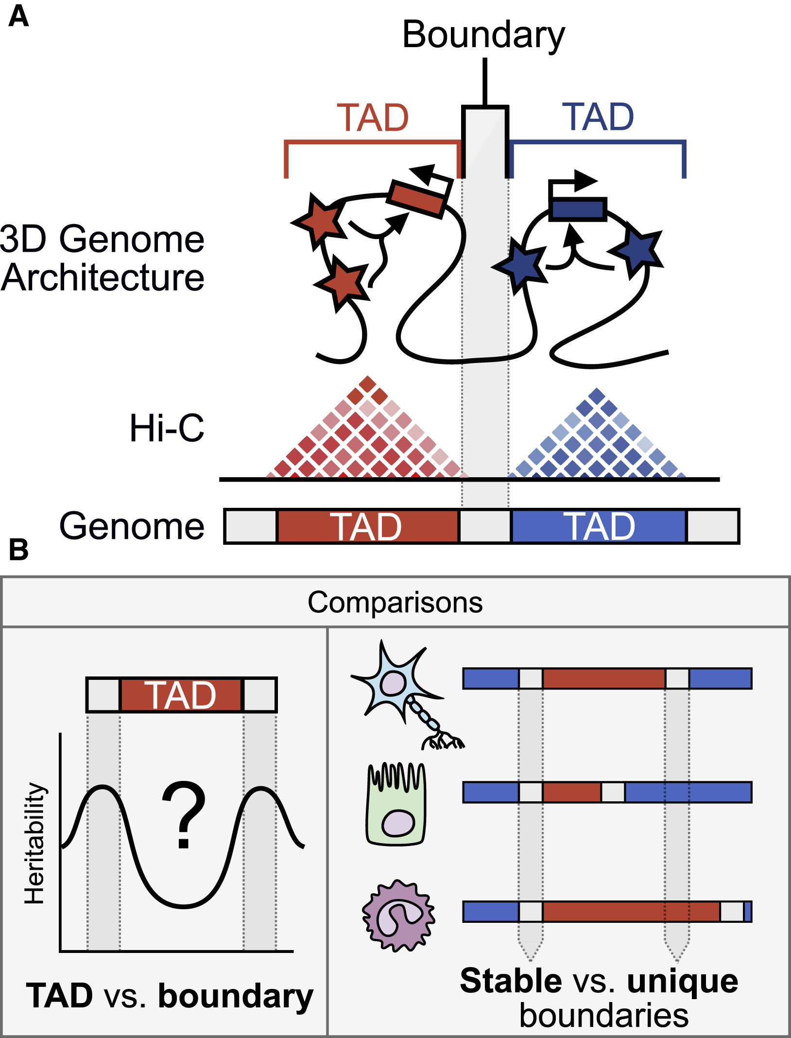
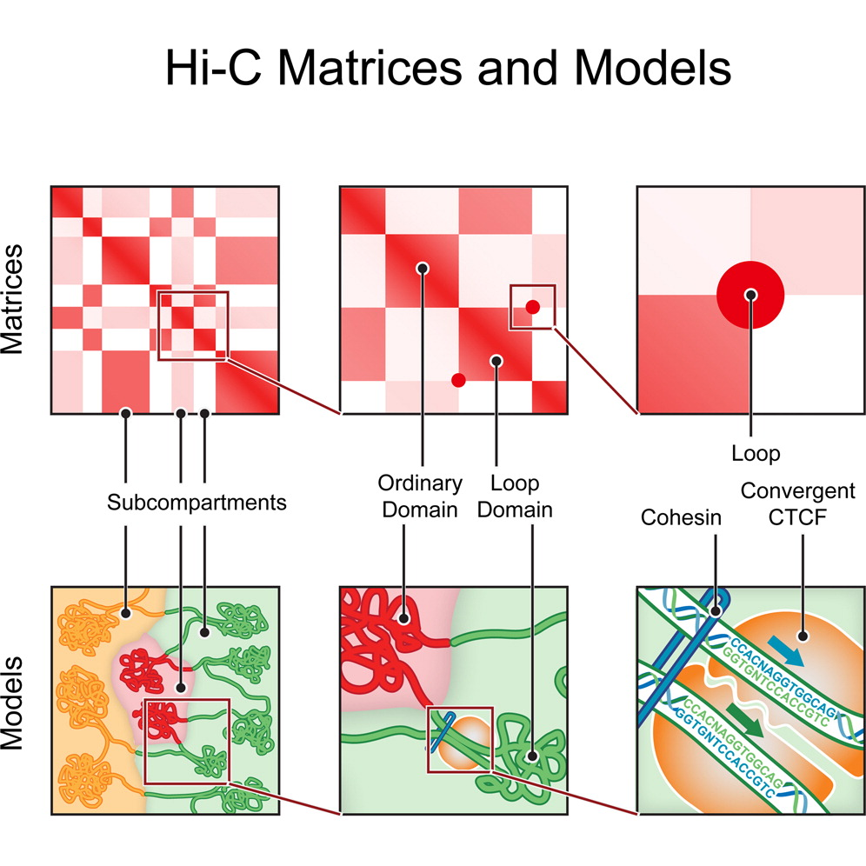
https://www.cell.com/fulltext/S0092-8674%2814%2901497-4
https://www.sciencedirect.com/science/article/pii/S000292972100001X

Slide 7
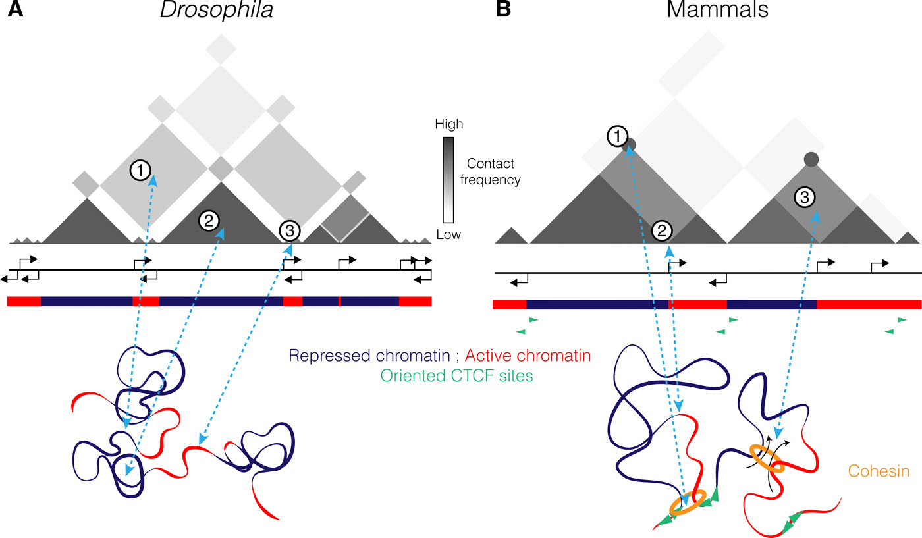
Read the Hi-C data (0)
https://www.science.org/doi/10.1126/sciadv.aaw1668

Slide 8
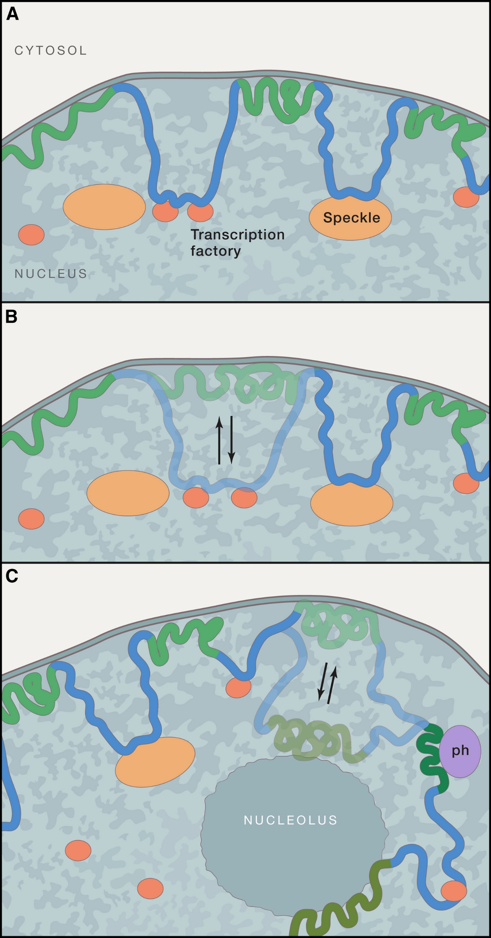
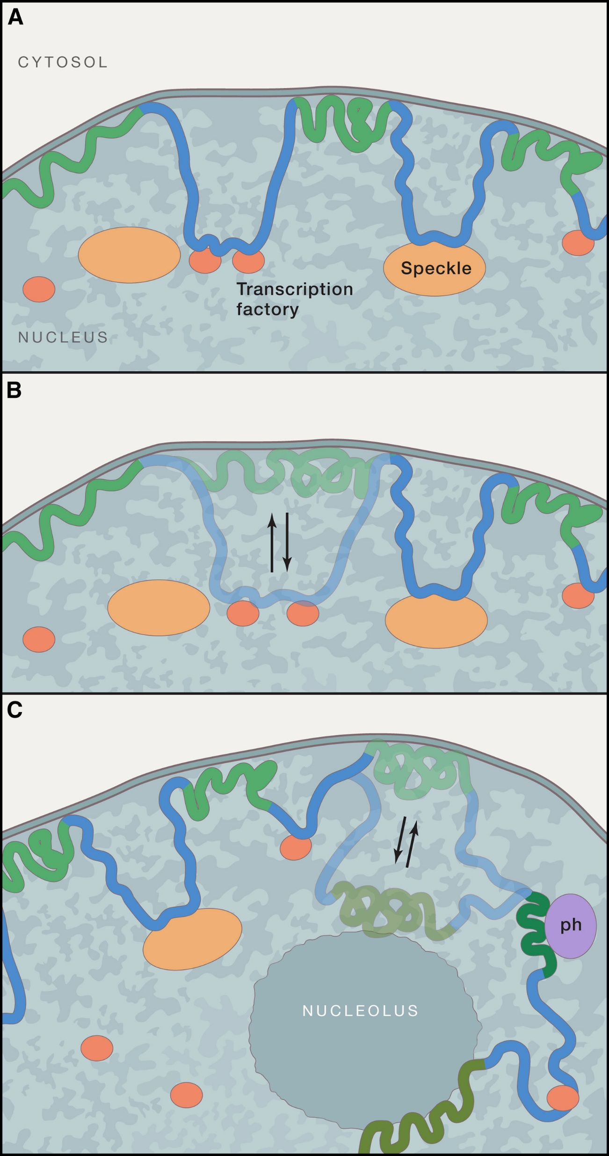
(A) Besides anchoring of LADs (green) to the NL, other regions (blue) may be tethered to nuclear structures that are permissive for transcription (orange), such as transcription factories (tf) or splicing factor speckles (speckles).
(B) Some LADs (semi-transparent green) contact the NL erratically (i.e., in a subset of cells) and may become transcriptionally active when associated with a permissive compartment (semi-transparent blue).
(C) Some LADs are apparently stochastically distributed between the NL, nucleoli, and pericentromeric heterochromatin (ph), which are all repressive environments.
https://www.cell.com/cell/fulltext/S0092-8674%2817%2930473-7

Slide 9
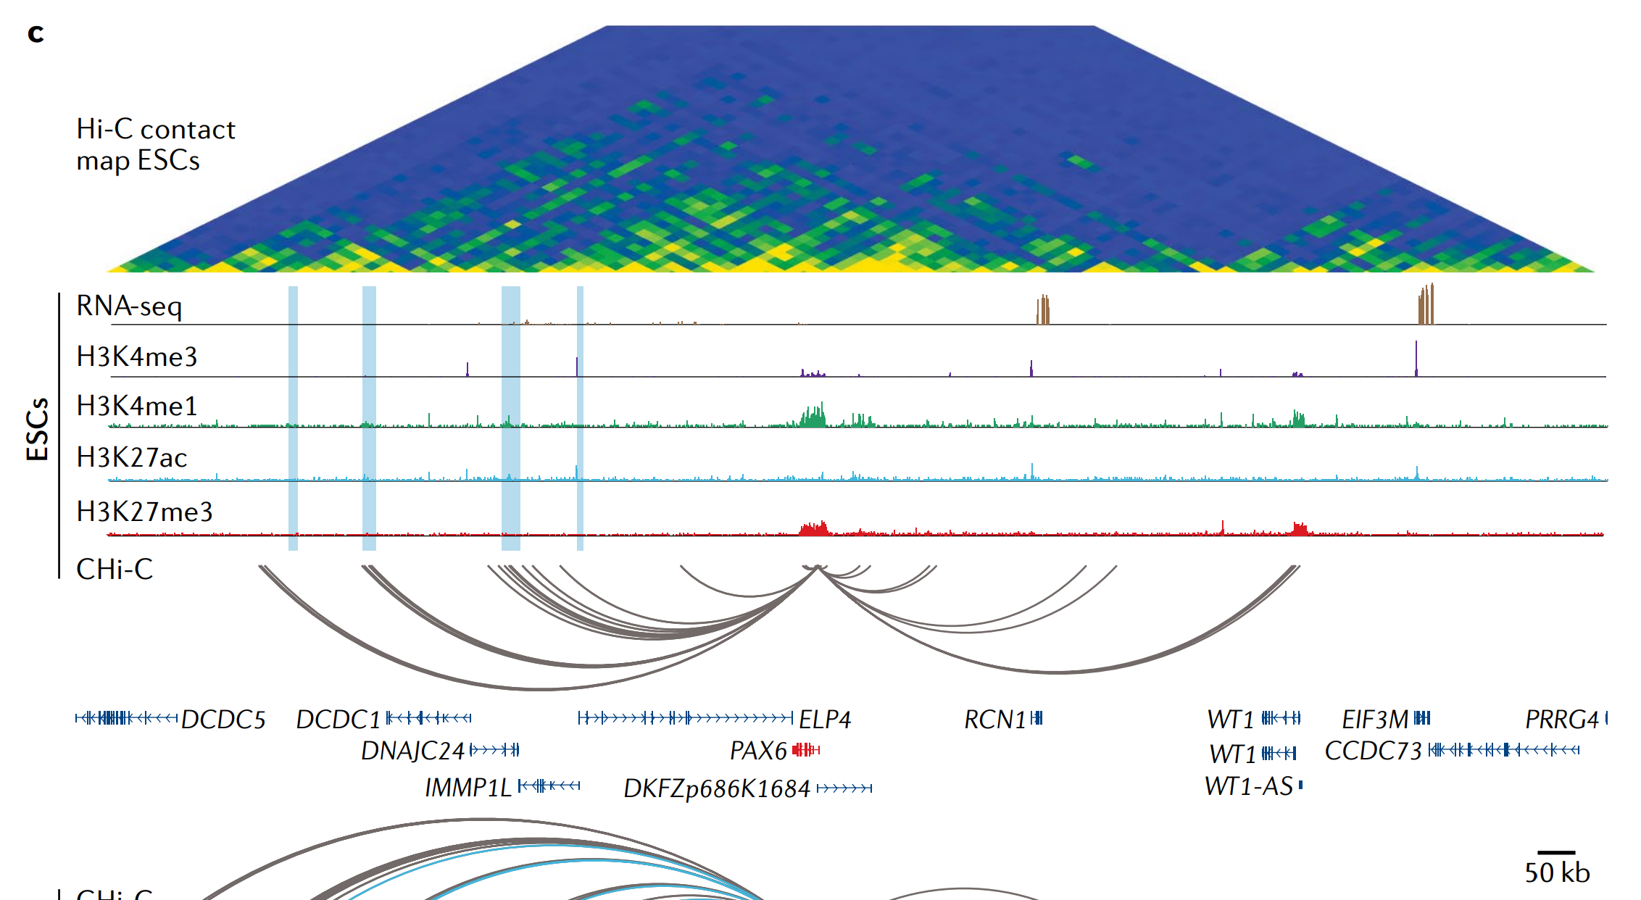
Read the Hi-C data (1)
https://www.nature.com/articles/s41576-019-0128-0

Slide 10
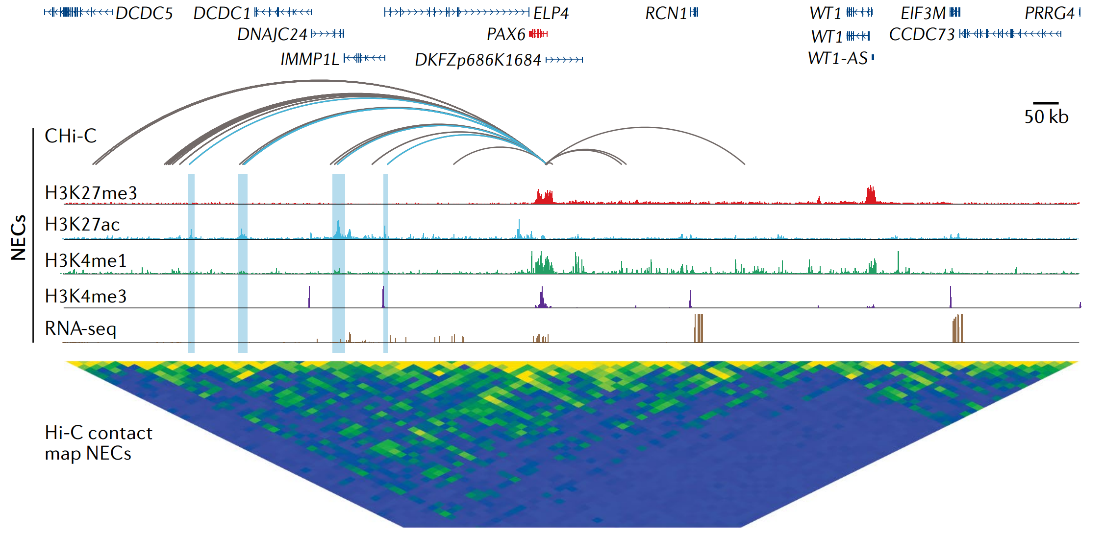
Read the Hi-C data (2)
https://www.nature.com/articles/s41576-019-0128-0

Slide 11
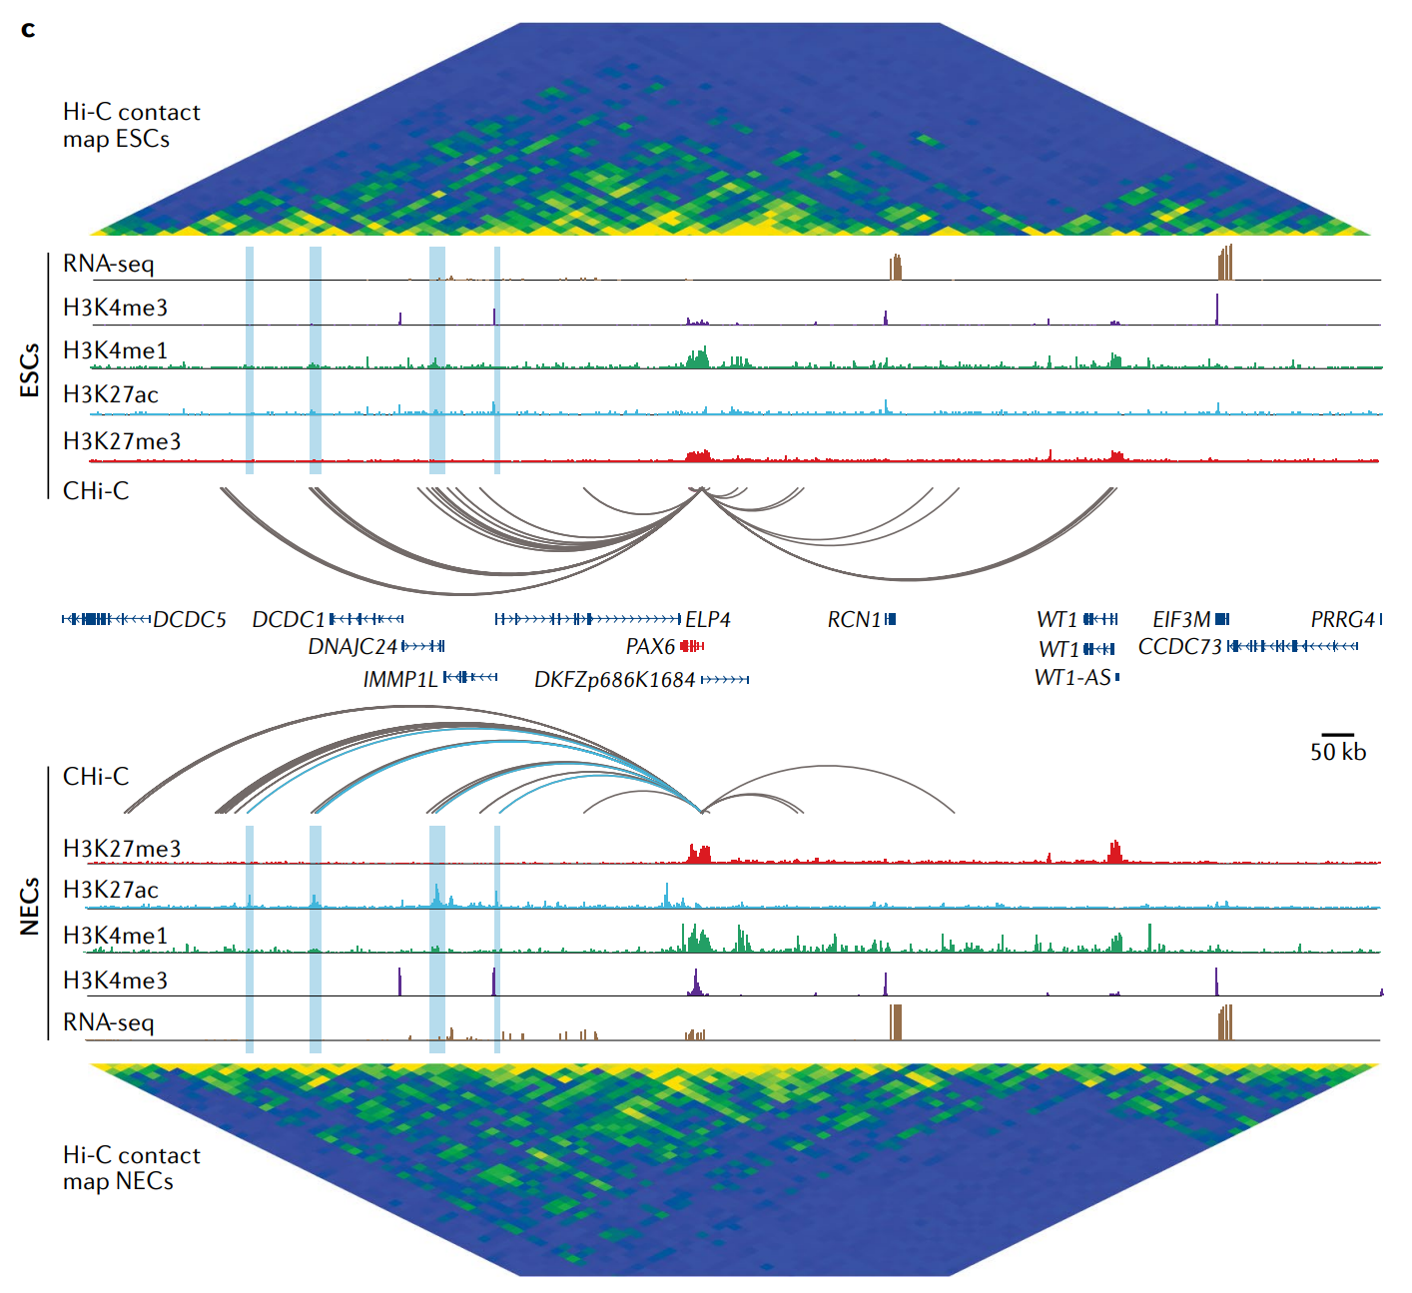
Read the Hi-C data (3)
https://www.nature.com/articles/s41576-019-0128-0

Slide 12
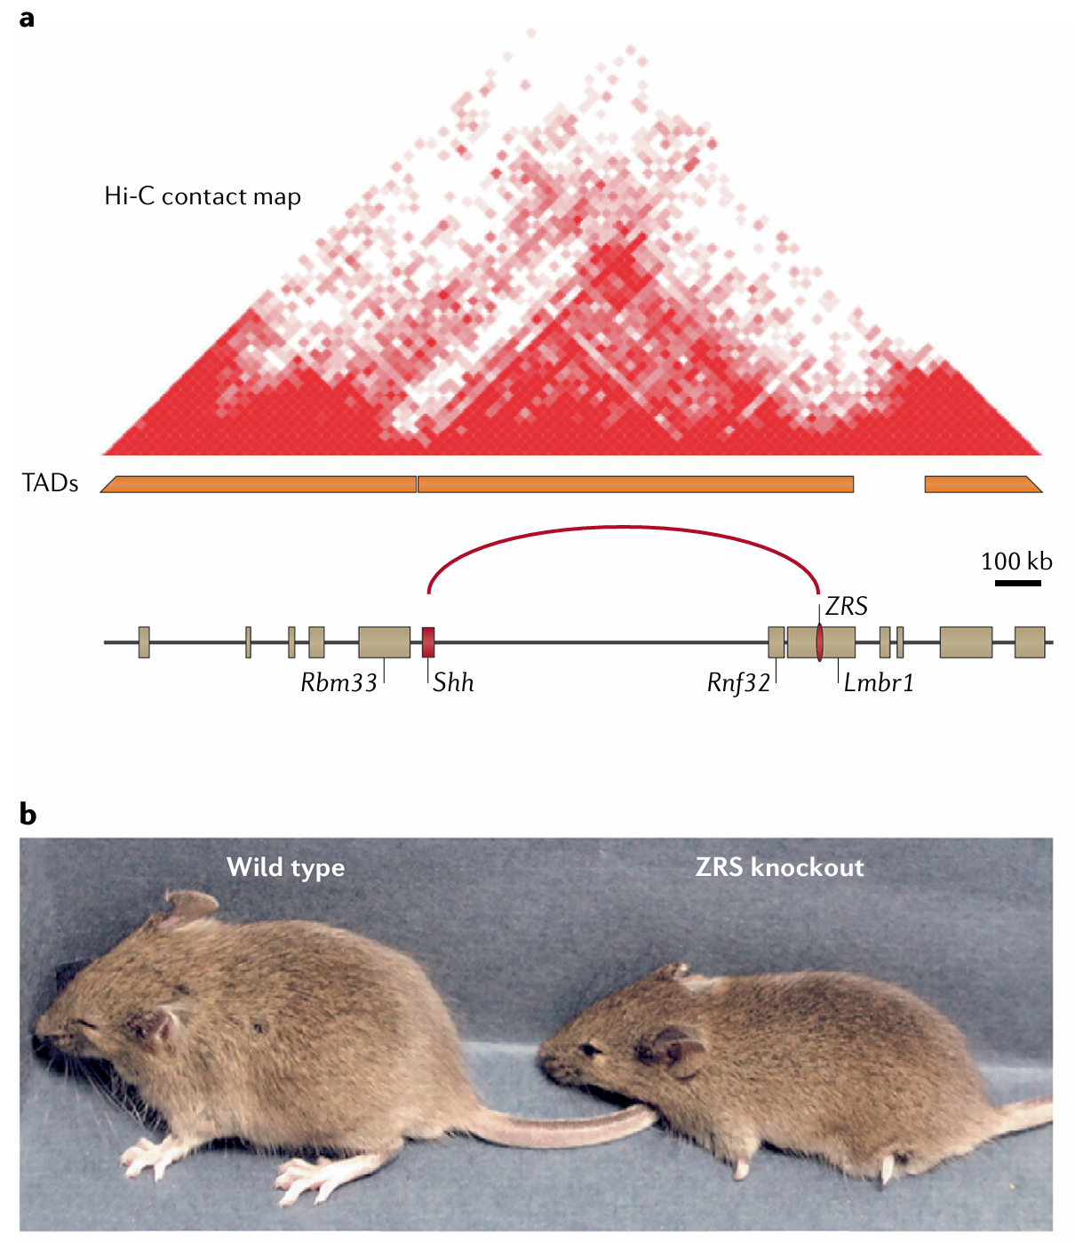
Fig. 2 | The Shh limb bud enhancer: a paradigm for long-range enhancer control of gene expression.
a | Genomic organization of the mouse sonic hedgehog (Shh) locus. In developing limb buds, the ‘zone of polarizing activity regulatory sequence’ (ZRS) enhancer controls the expression of Shh located ~850 kb away.
b | Mice lacking the ZRS Shh limb bud enhancer are born with severely truncated limbs.
https://www.nature.com/articles/s41576-019-0128-0

Slide 13
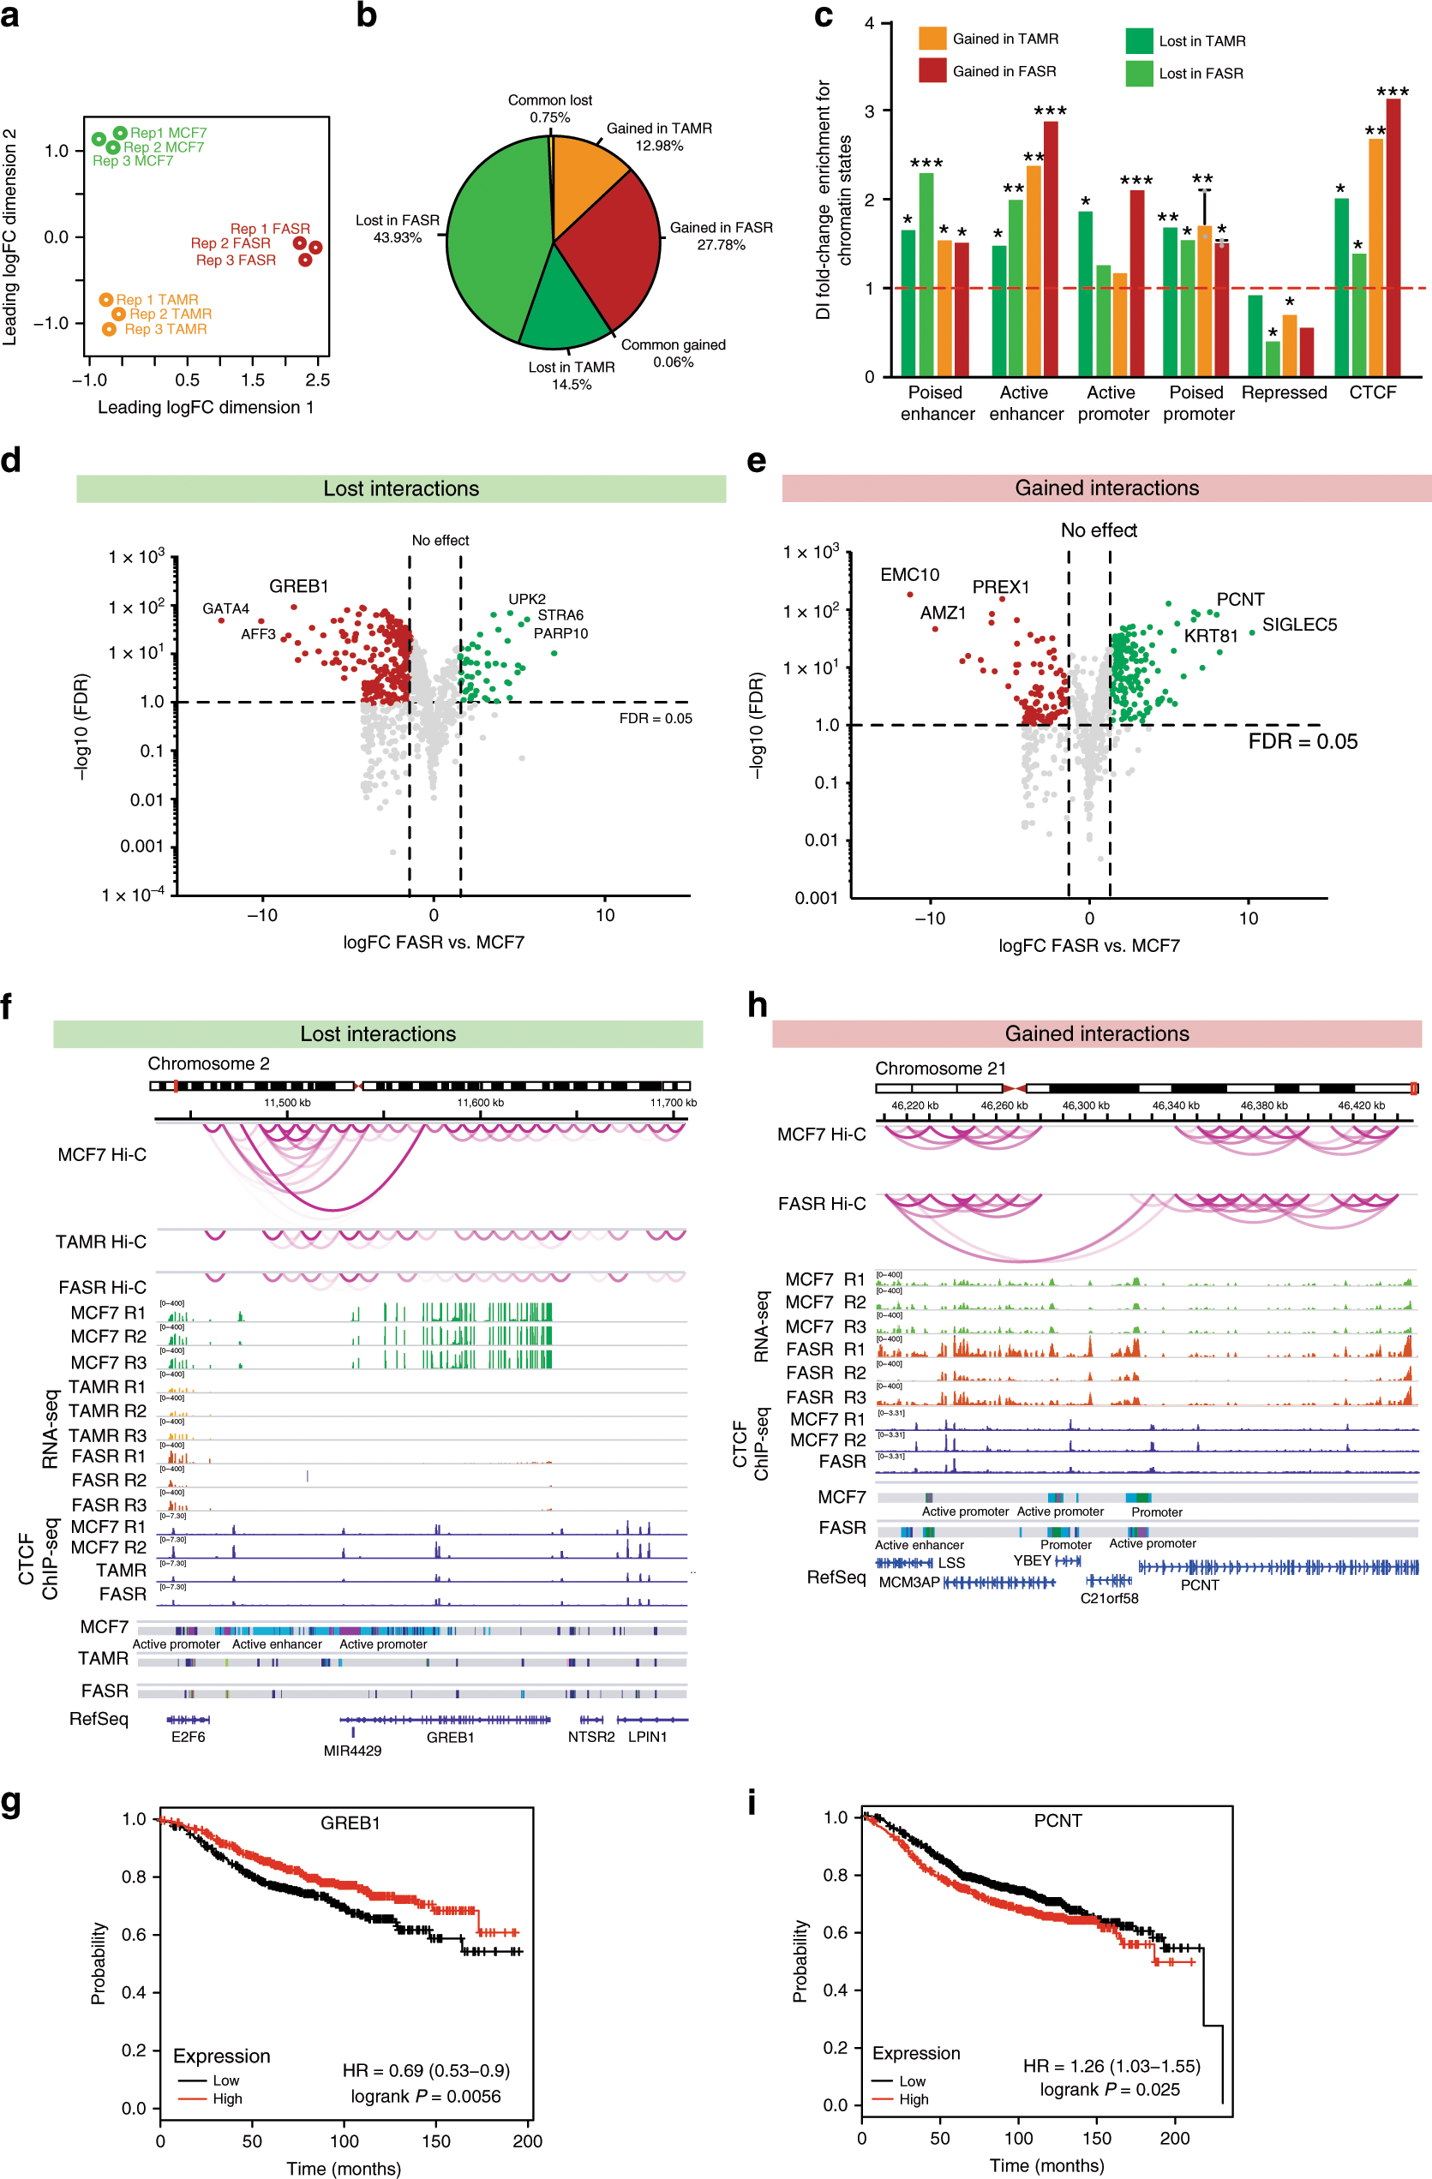
Differential enhancer−promoter interactions and gene deregulation
https://www.nature.com/articles/s41467-019-14098-x

Slide 14
Differential enhancer−promoter interactions and gene deregulation
https://www.nature.com/articles/s41467-019-14098-x

Slide 15
Differential enhancer−promoter interactions and gene deregulation
https://www.nature.com/articles/s41467-019-14098-x

Slide 16
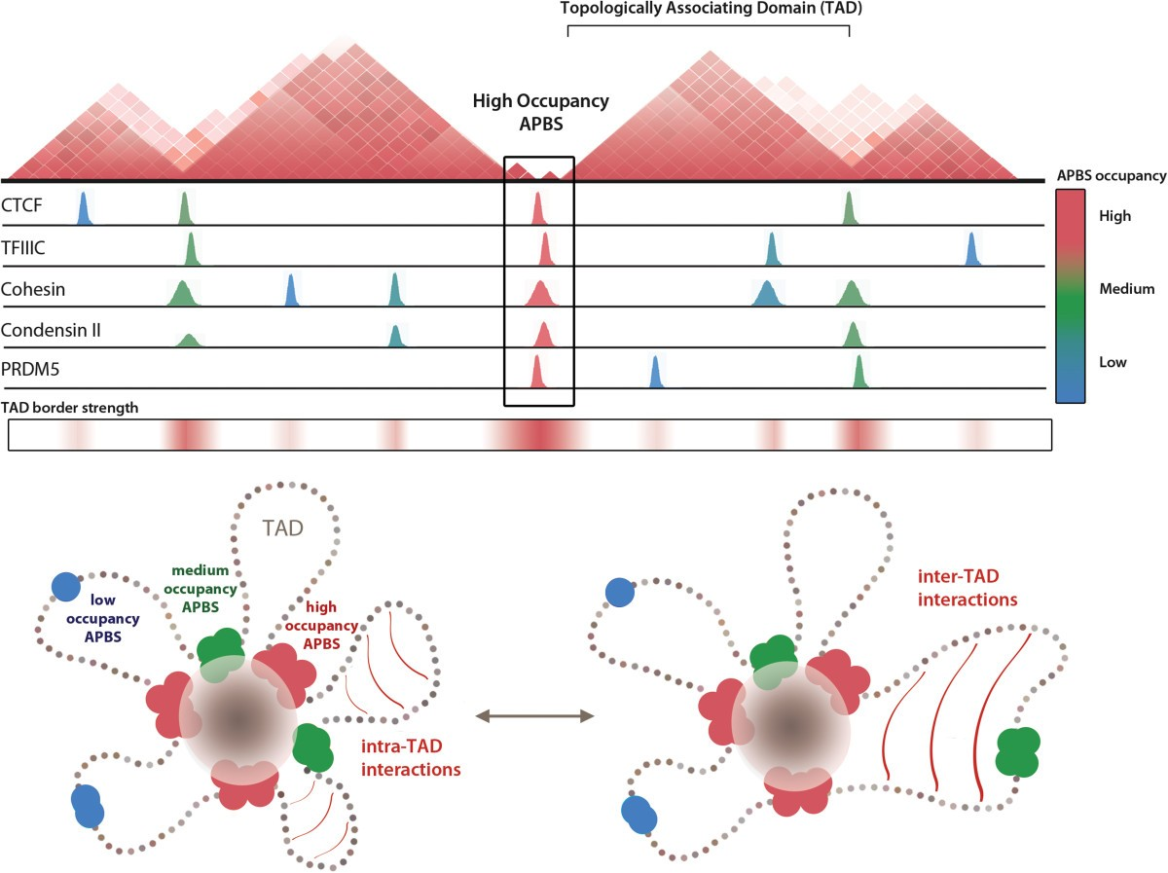
Combinatorial binding of architectural proteins shapes topological domain structure
https://genomebiology.biomedcentral.com/articles/10.1186/gb-2014-15-5-r82

Slide 17
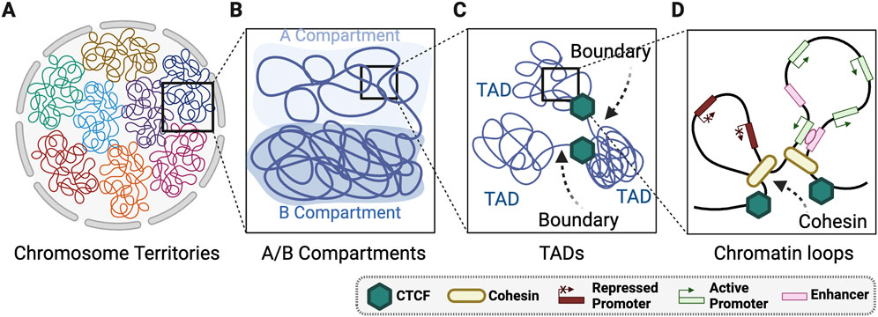
Layers of 3D genome organisation
https://doi.org/10.3389/fcell.2025.1548946

Slide 18
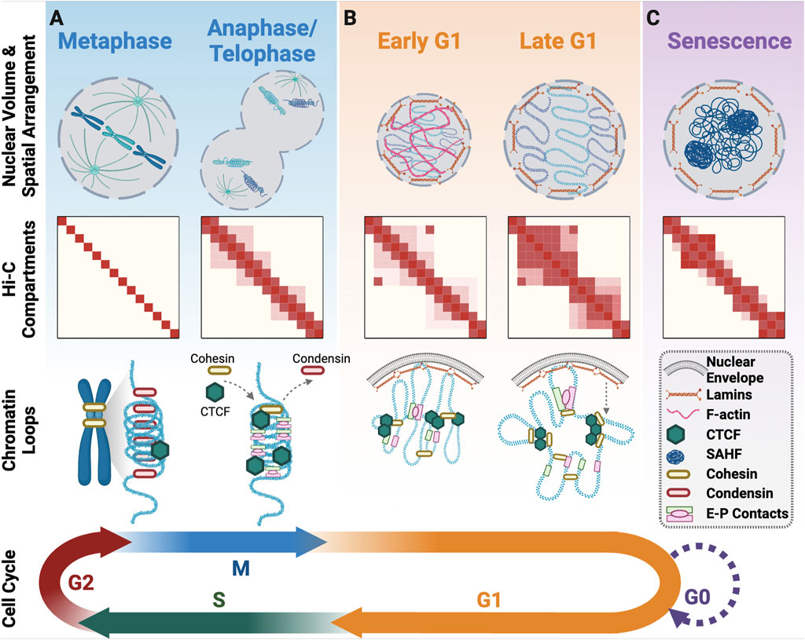
3D genome organisation upon cell cycle exit and re-entry
https://doi.org/10.3389/fcell.2025.1548946

Slide 19
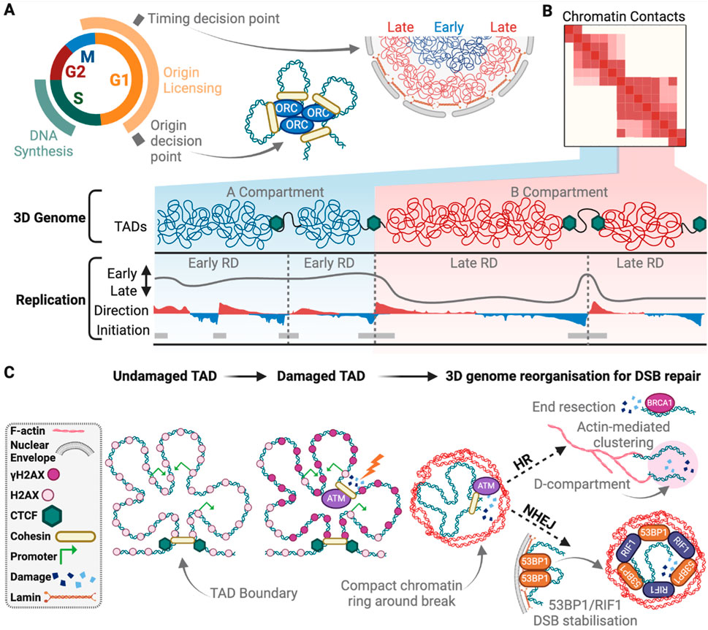
The 3D genome in DNA replication and repair
https://doi.org/10.3389/fcell.2025.1548946

Slide 20
ChIP-seq for Histone modifications, TFBSs and DNAaseI Hypersensitivity

Slide 21
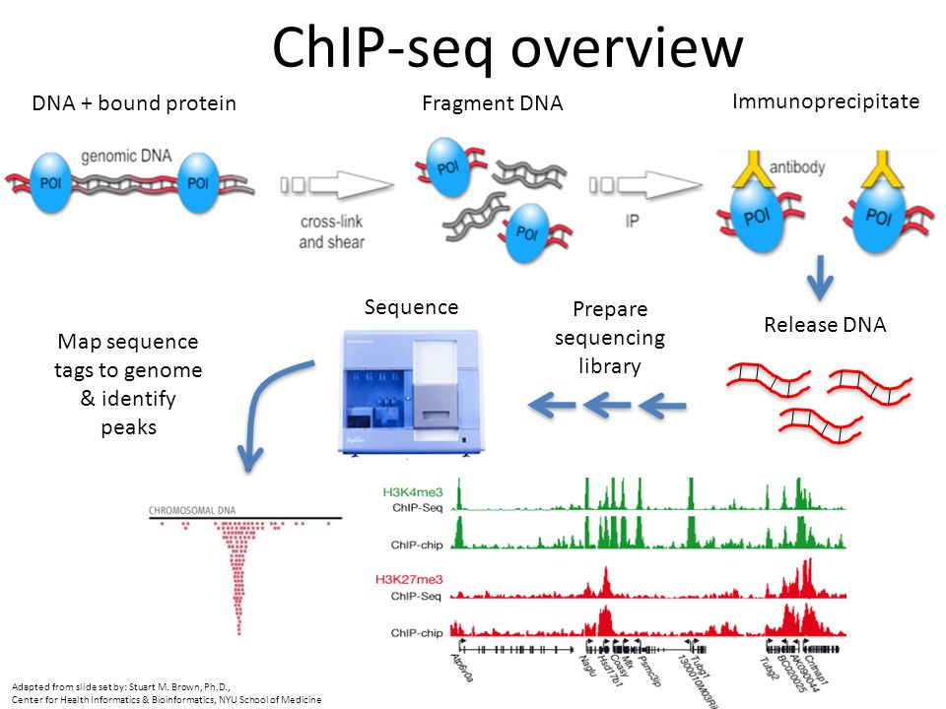
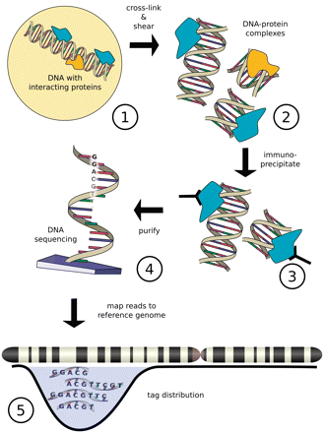
Figure from Szalkowski, A.M, and Schmid, C.D.(2010). Rapid innovation in ChIP-seq peak-calling algorithms is outdistancing banchmarking efforts. Briefings in Bioinfomatics.

Slide 22
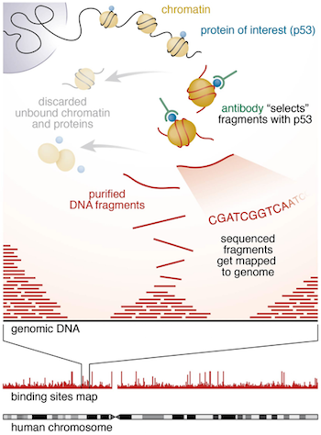
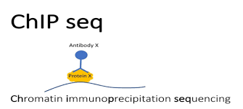
https://hbctraining.github.io/Intro-to-ChIPseq/lessons/01_Intro_chipseq_data_organization.html

Slide 23
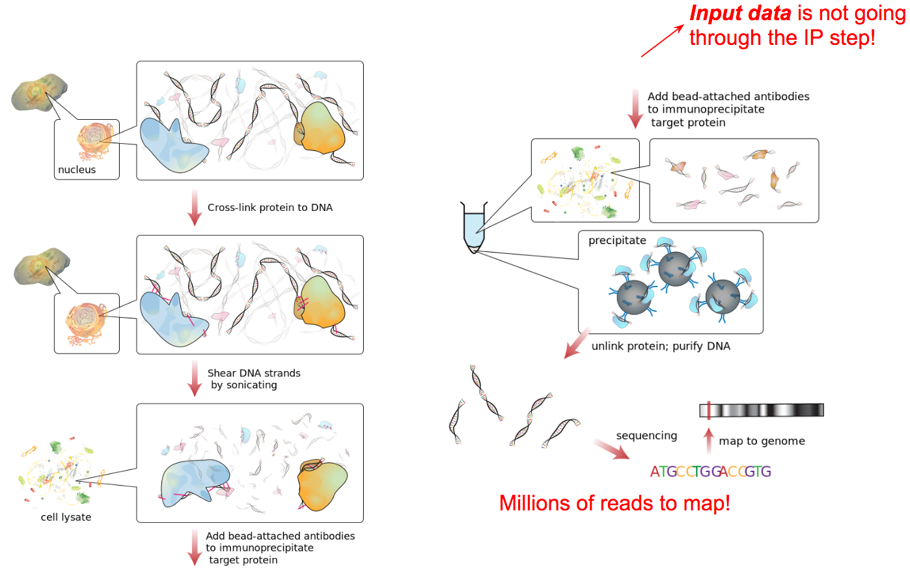
https://training.galaxyproject.org/training-material/topics/epigenetics/tutorials/formation_of_super-structures_on_xi/slides-plain.html

Slide 24
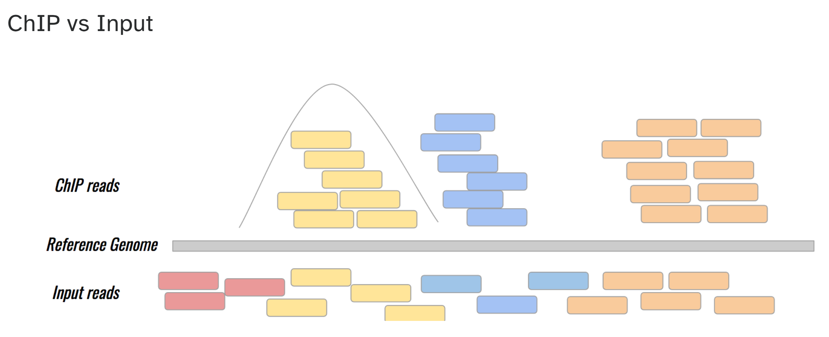
https://training.galaxyproject.org/training-material/topics/epigenetics/tutorials/formation_of_super-structures_on_xi/slides-plain.html

Slide 25
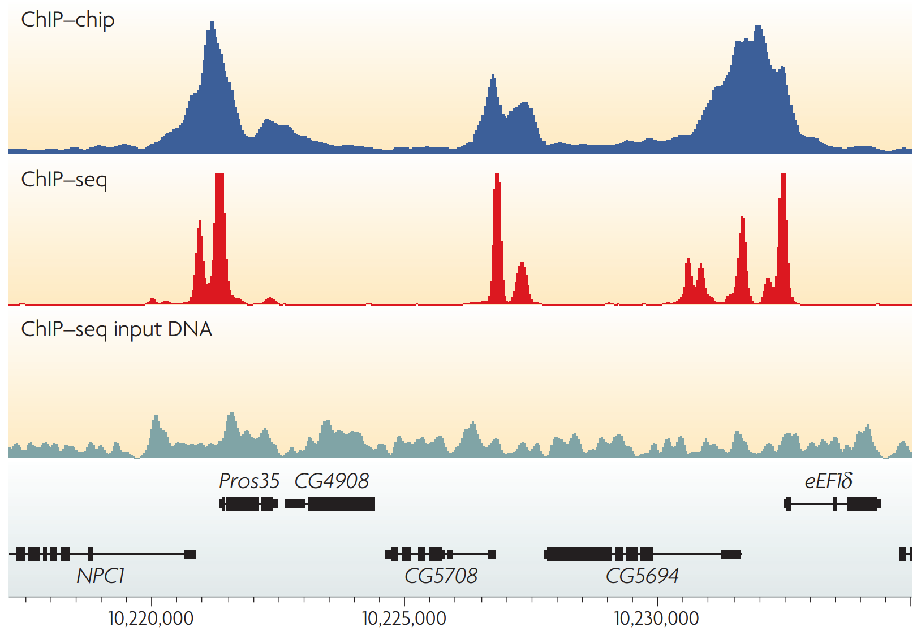
ChIP profiles: Examples of the profiles generated by chromatin immunoprecipitation
https://www.nature.com/articles/nrg2641

Slide 26
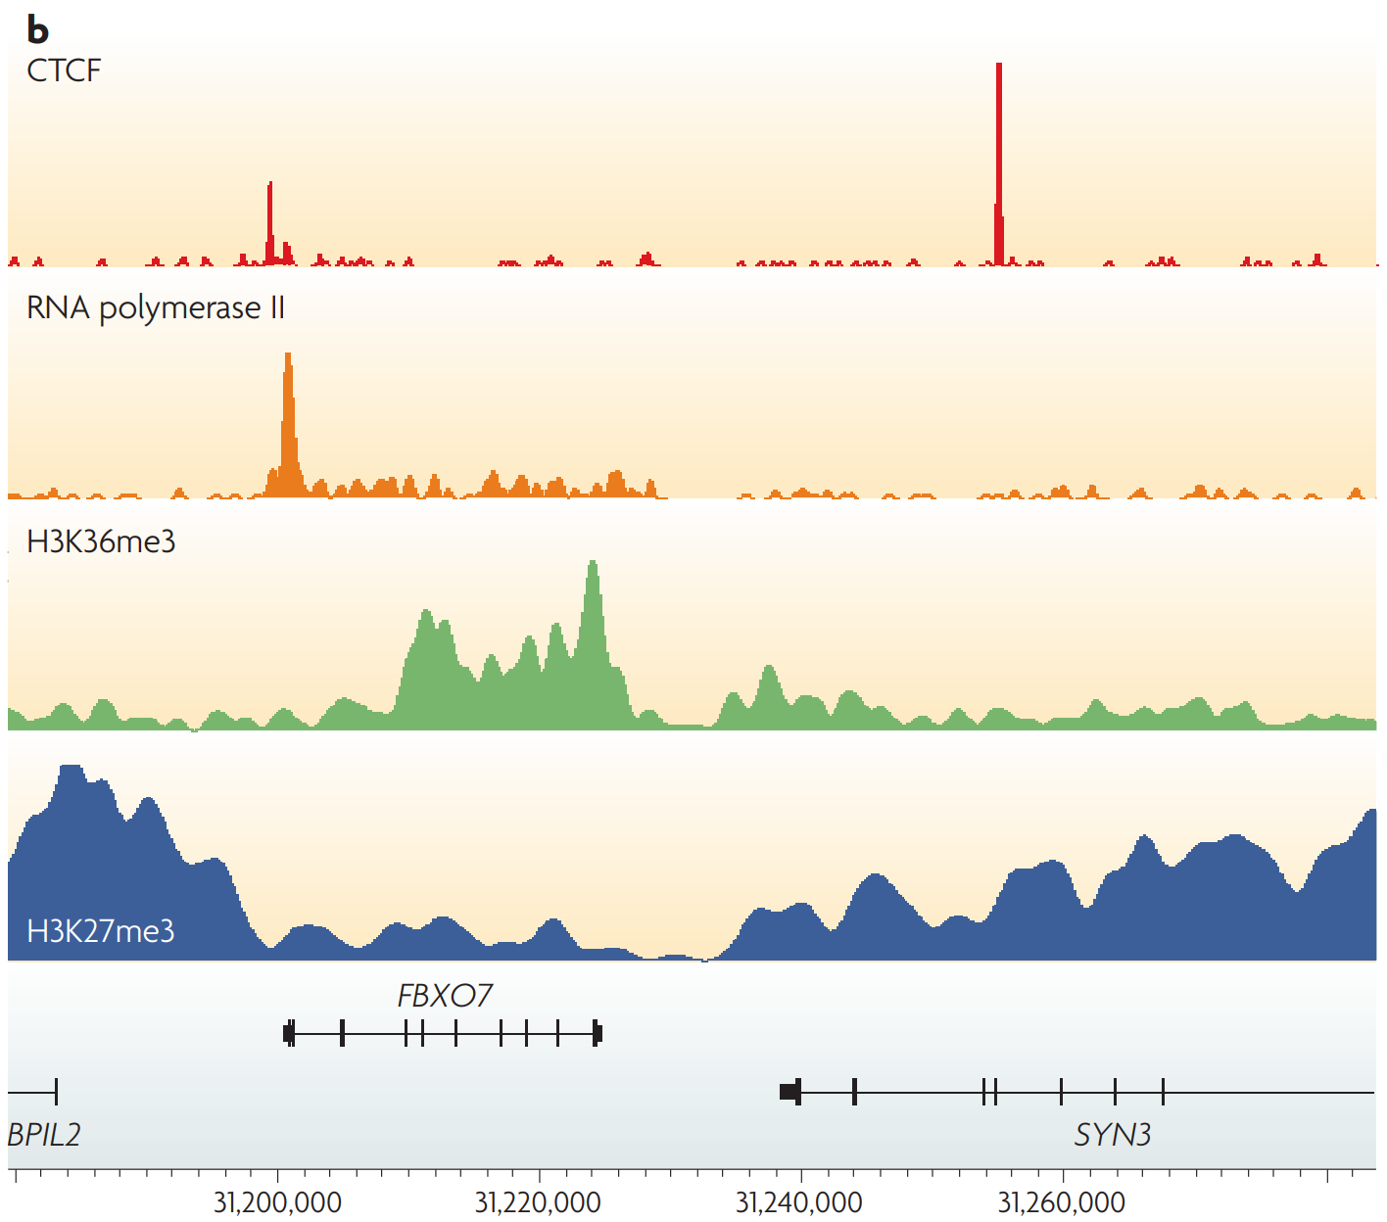
ChIP profiles: Examples of different types of ChIP–seq tag density profiles in human T cells
https://www.nature.com/articles/nrg2641

Slide 27
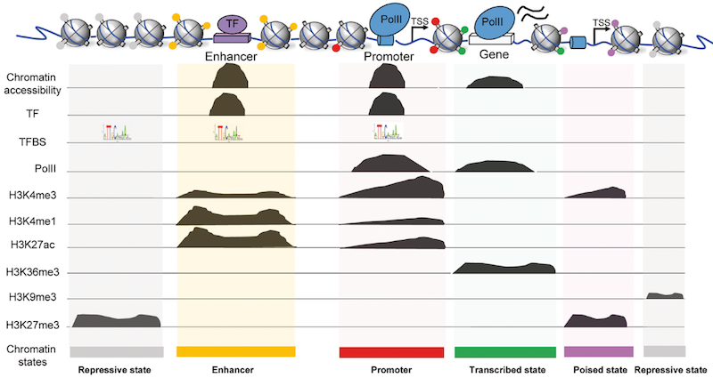
Types of ChIP-seq
https://training.galaxyproject.org/training-material/topics/epigenetics/tutorials/formation_of_super-structures_on_xi/slides-plain.html

Slide 28
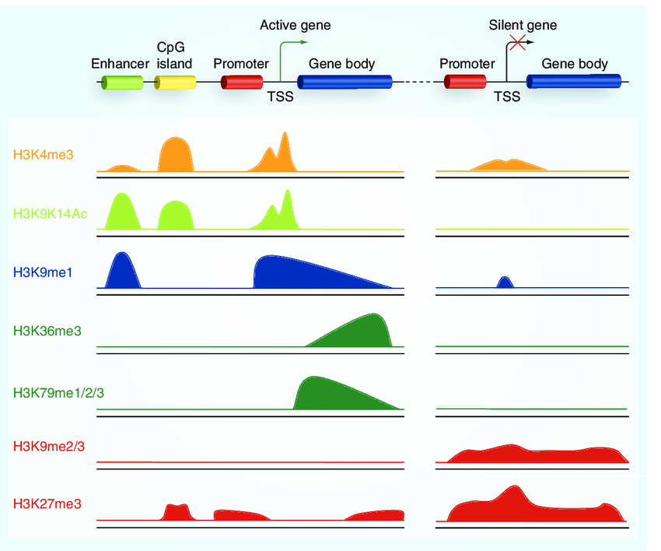
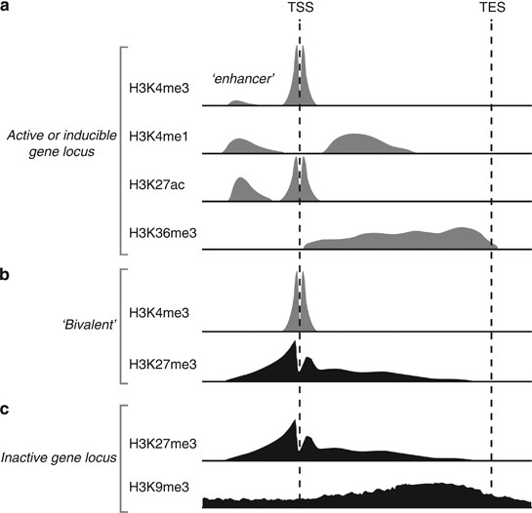
Peak types and locations of histone methylation
https://www.nature.com/articles/jhg201366
DOI:10.2217/epi.10.55

Slide 29
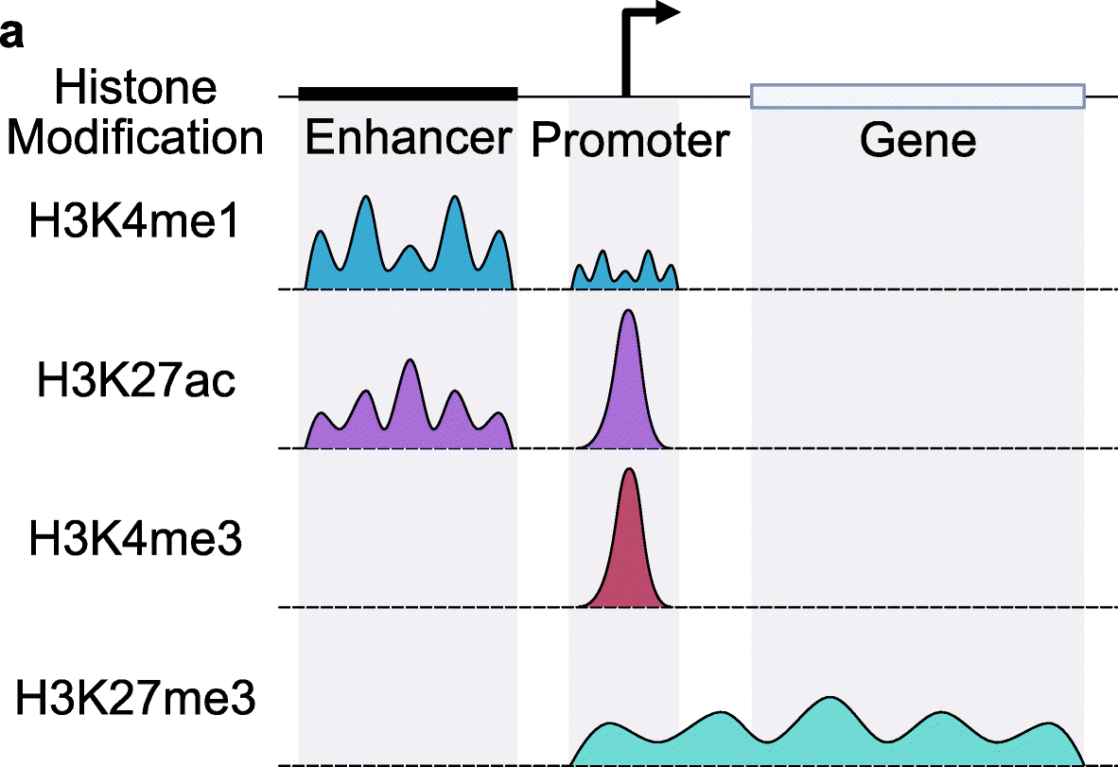
Peak types and locations of histone modifications
https://genomebiology.biomedcentral.com/articles/10.1186/s13059-022-02707-w

Slide 30
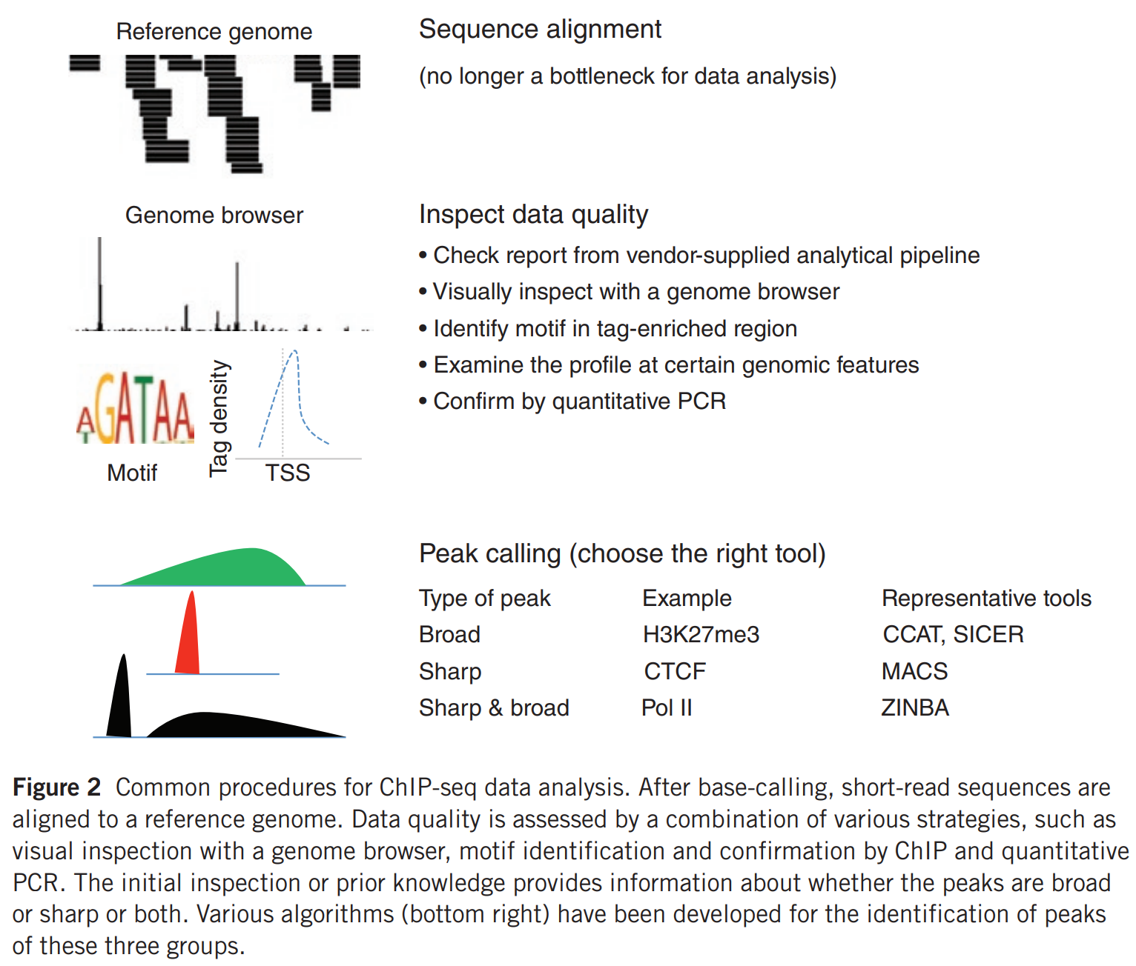
https://www.nature.com/articles/ni.2117

Slide 31
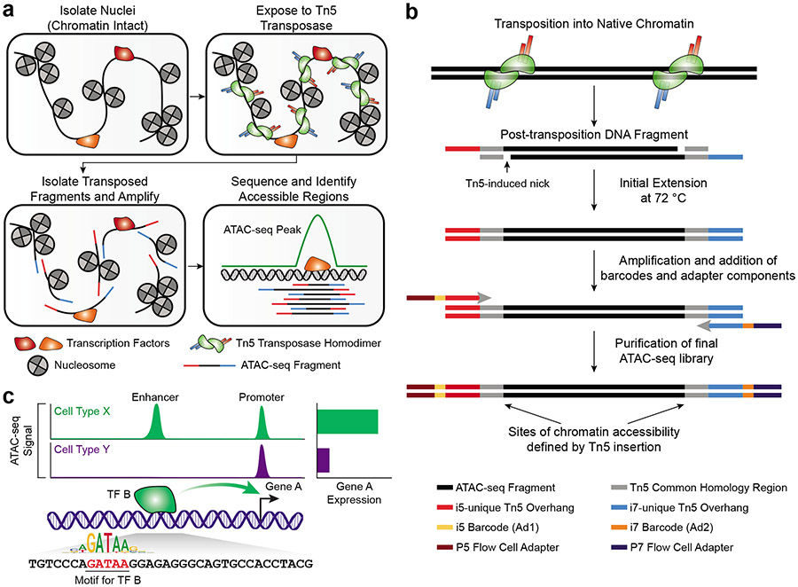
ATAC-seq
https://pubmed.ncbi.nlm.nih.gov/35478247/

Slide 32
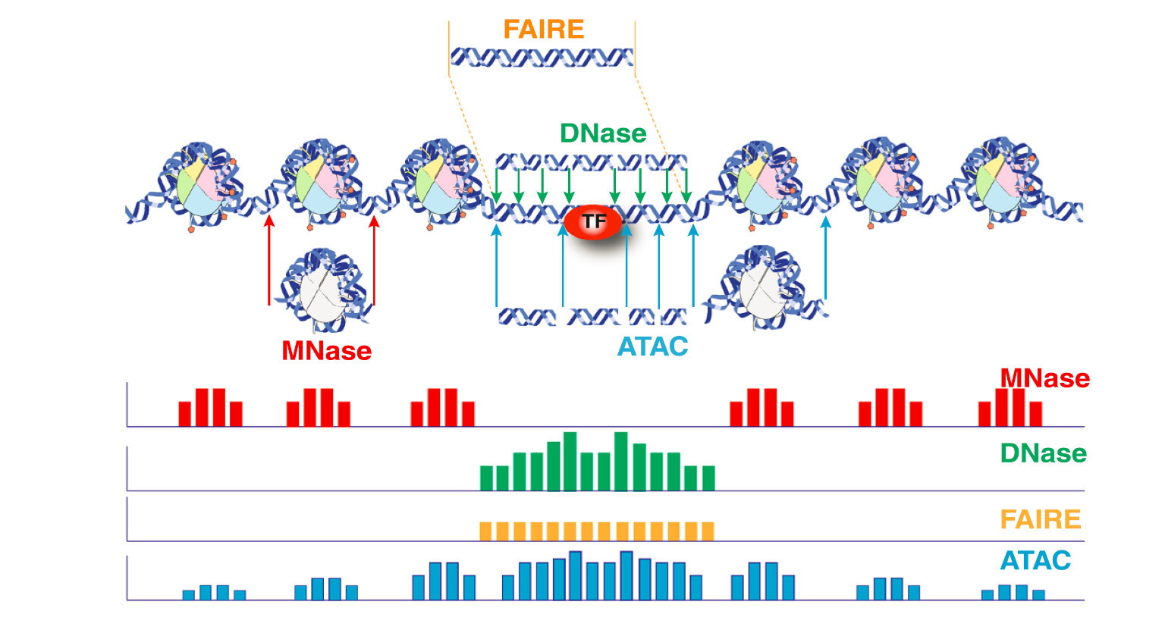
ATAC-seq
https://haibol2016.github.io/ATACseqQCWorkshop/articles/ATACseqQC_workshop.html

Slide 33
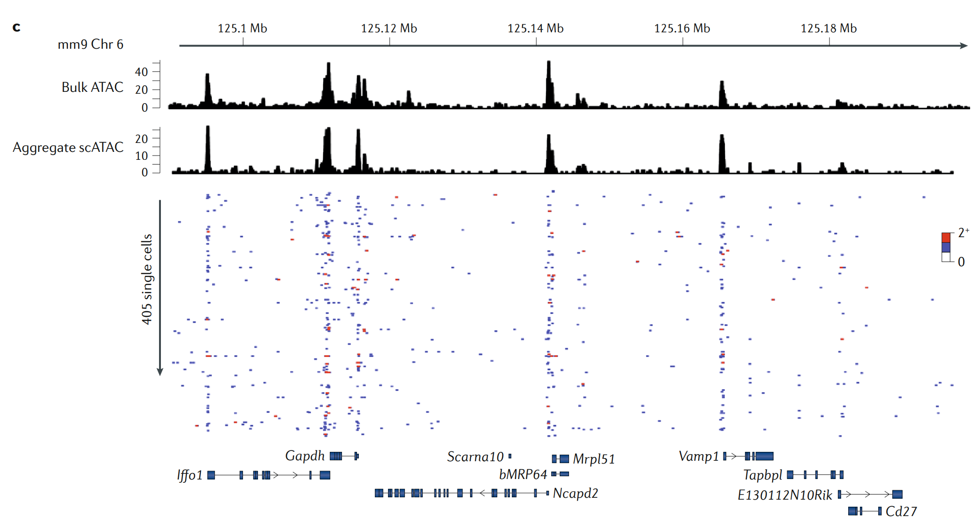
Population-scale measurements of chromatin accessibility reflect the average accessibility of a heterogeneous collection of single molecules
https://www.nature.com/articles/s41576-018-0089-8

